Slide 1
Front
Heidi
Jessie
Brenda
Linus
Jessica
Steven
Nicole
Waitlisted/
Auditors

Slide 2



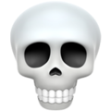
Dark Design Patterns
Week 10

Slide 3
Announcements
Final Project check-in: due this Wednesday, April 17th
Will check off during/after lab, but please try to do it before then if possible
Final Project: due in exactly two (2!!) weeks on Monday, April 29th
Come to OH (wdd.io/go/OH)
NOT submitted on portal! We will not grade portal submissions!
Please be here for Github deployment lab
Time manage wisely — difficult to make a website completely from scratch in 1 hour
If you haven’t started, start today

Slide 4



Plug: IDEO Discussion on Tech for Social Impact
Thursday, April 18 (7-9pm), Cheit Hall in Haas
Blueprint x The Berkeley Forum — Ian Lee, Haas MBA alum + studied human computer interaction/econ as an undergrad. Introduced blockchain to Berkeley’s grad curriculum, and helps businesses use blockchain/tech for social impact - free sliver!

Slide 5
Regarding feedback on tangents
Most “practical” lectures coming in next two weeks — building a portfolio, recruiting, Q&A

Slide 6
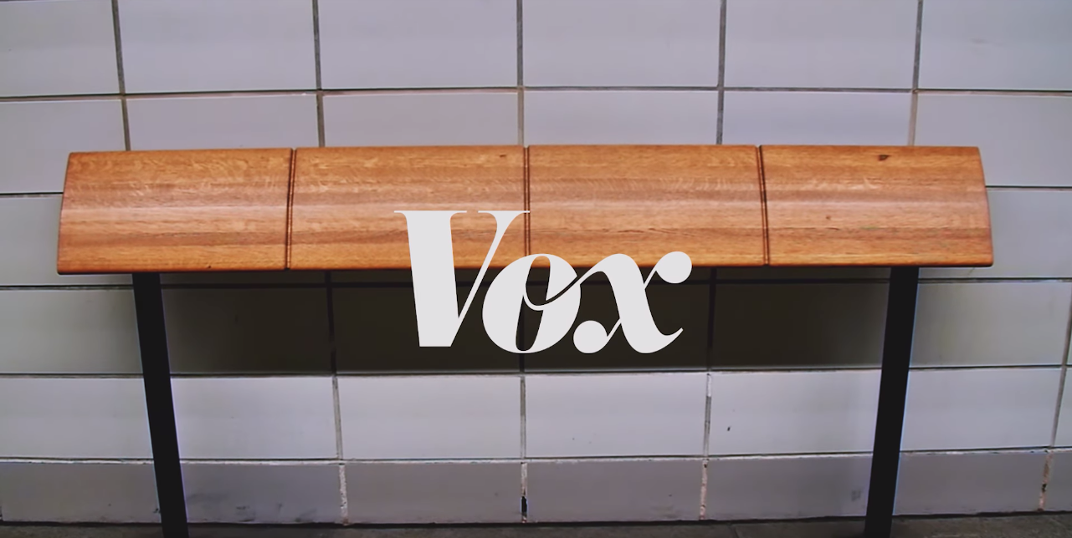
Why cities are full of uncomfortable benches, Vox

Slide 7
let’s get a lil’ technical

Slide 8
Defensive Design
(n.) the practice of anticipating all possible ways that an end-user could misuse a device, and designing the device so as to make such misuse impossible, or to minimize the negative consequences

Slide 9
Dark/Unpleasant Design
(n.) a user interface that has been carefully crafted to trick users into doing things, such as buying insurance with their purchase or signing up for recurring bills

Slide 10
More Terms

Slide 11
Forced Disclosure
(n.) a user interface that has been carefully crafted to trick users into doing things, such as buying insurance with their purchase or signing up for recurring bills

Slide 12
Forced Continuity
(n.) When your free trial with a service comes to an end and your credit card silently starts getting charged without any warning. In some cases this is made even worse by making it difficult to cancel the membership.

Slide 13
Bait-and-switch
(v.) to advertise a free (or greatly reduced) product or service which is wholly unavailable or stocked in small quantities. After it is apparent the product is no longer available, they are exposed to other priced products similar to the one advertised.

Slide 14
asshole designs

Slide 16

This Instagram Story ad with a fake hair in it is sort of disturbing, The Verge

Slide 17
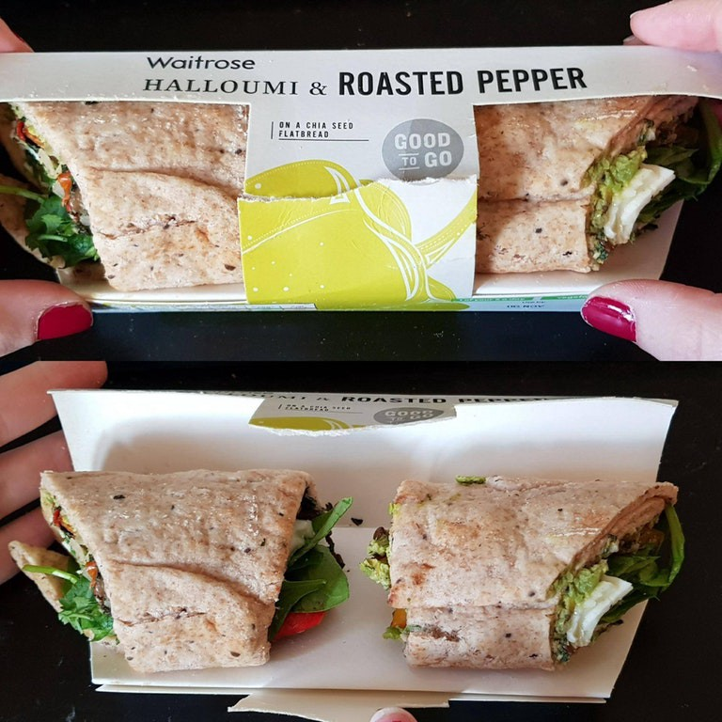

Slide 18
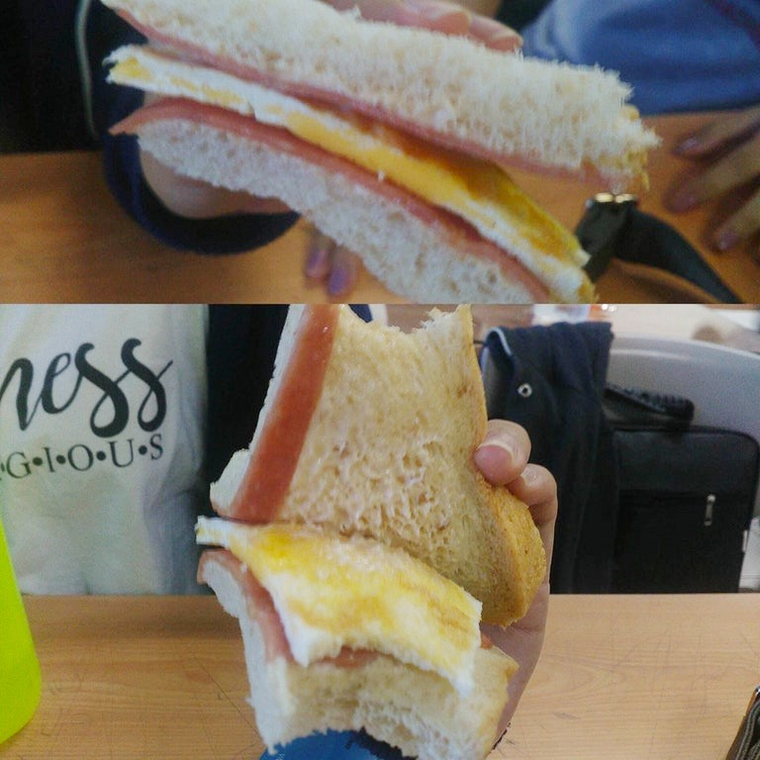

Slide 19
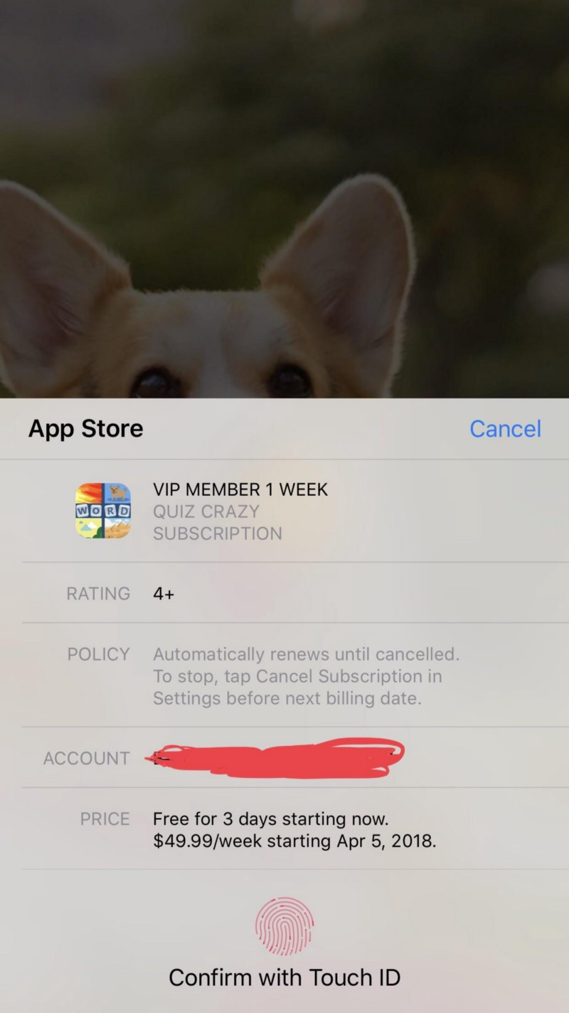

Slide 20
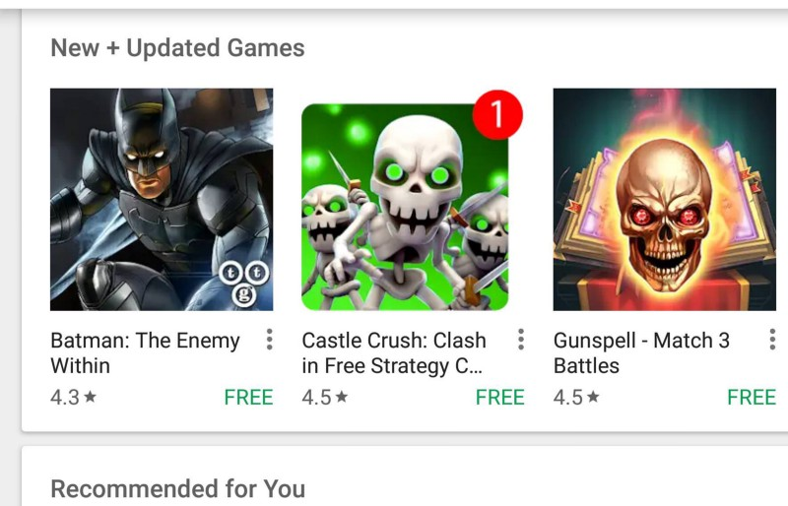

Slide 22
“There’s a simple reason why brands employ dark UX tactics. They want to nudge the user towards — or away from — certain actions in order to drive sales, gather more data or bump up their email lists.”

Slide 23
From Nuisance to Regret

Slide 24
Ethical Concerns

Slide 25
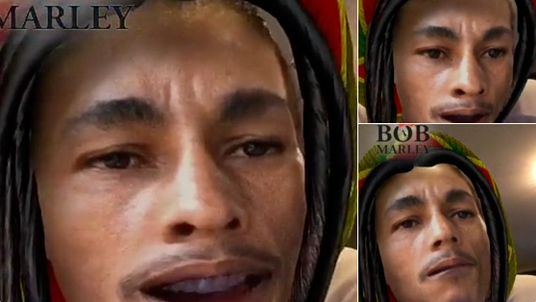
2014 — Snapchat’s Digital Blackface

Slide 26
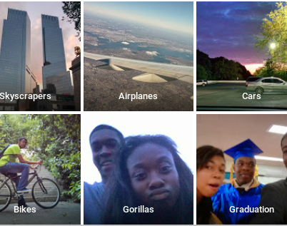
2015 — Google Photos Algorithm

Slide 27
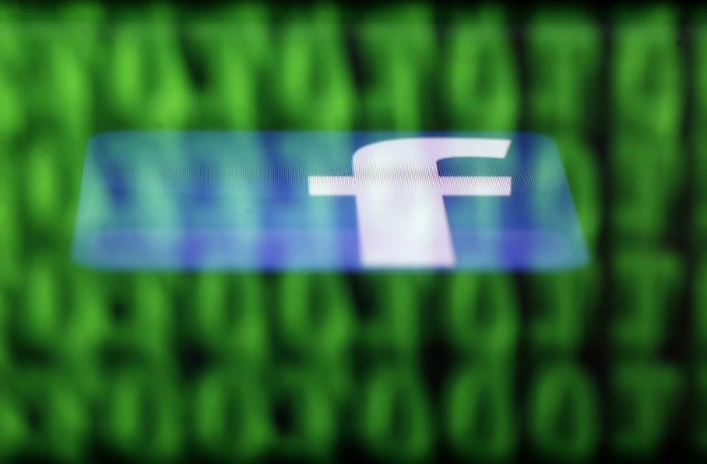
Facebooks’ Emotional Manipulation Experiment

Slide 28
High-Level: What does this mean for designers?

Slide 29
As a UX designer, you have a responsibility towards both the brand and the user. It is your job to create unbeatable user experiences — experiences that are transparent and unambiguous, making it easy for the user to take the course of action they had indeed set out to take.

Slide 30
Short Partner Activity (3 min)
What are some dark patterns in your own daily interactions you’ve noticed?

Slide 31
Share Out!

Slide 32
Short Partner Activity (3 min)
What are some great patterns in your own daily interactions you’ve noticed?

Slide 33
Dear Design Student

Slide 34
Questions?

